Slide 1

Automatic Humidifier
Andrew Sherwin - Woojin Kim - Jalen Chen
TA: Surya Vasanth
Professor: Dr. Jonathon Schuh

Slide 2

Problem
Environmental Protection Agency highly suggests 30-50% humidity indoors
Chemicals, gasses, pollen, mold, and other particles are reduced
Most cheap humidifiers are actually bad for the user's health
Warm mist – cause nasal passages to swell
Ultrasound – displaces minerals and bacteria
Manual humidifiers can over/under humidity
Humidifiers on market need manual water refilling

Slide 3
Solution
Cool mist humidifier
Good for health
Evaporates water off filter
Remote humidity sensing via 3 sensors
Automatic on/off humidifier based on humidity
Automatic water valve with water level sensing

Slide 4
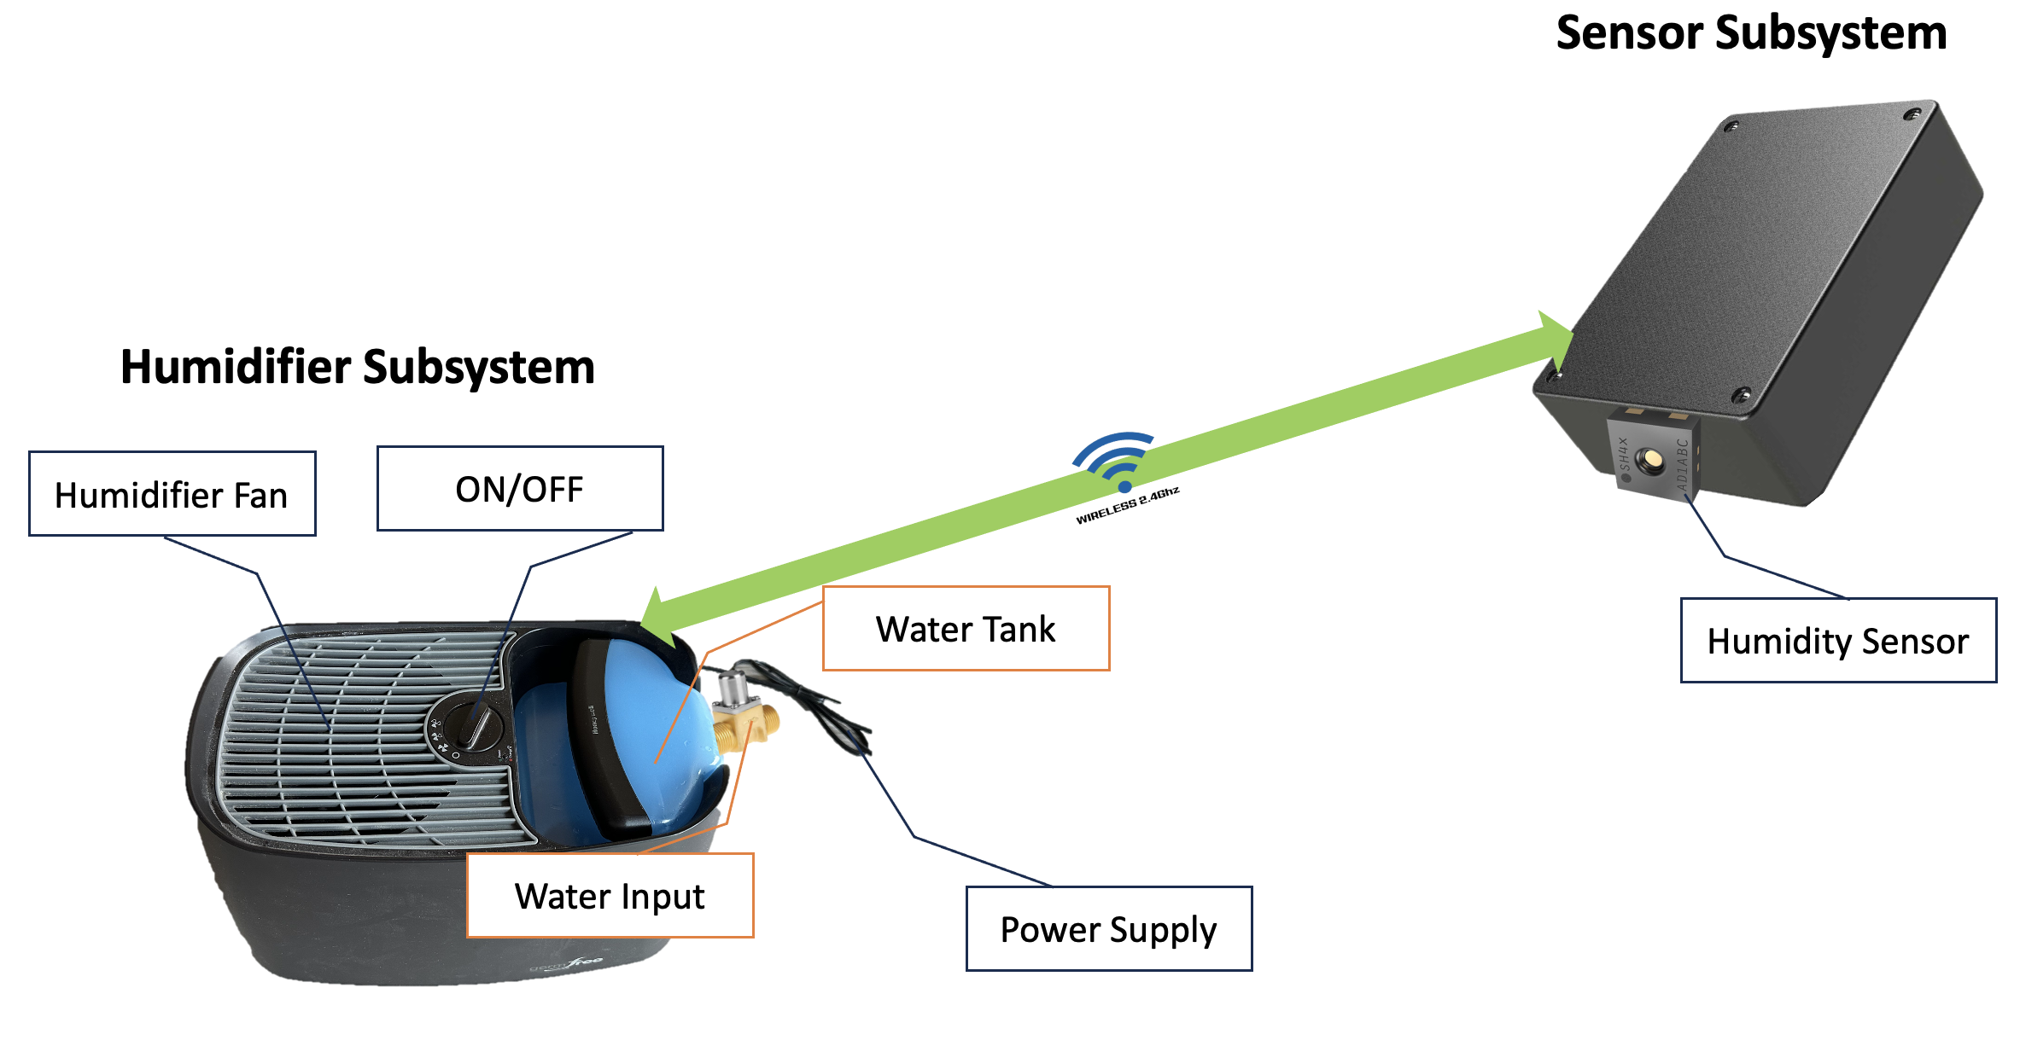
Visual Aid

Slide 5
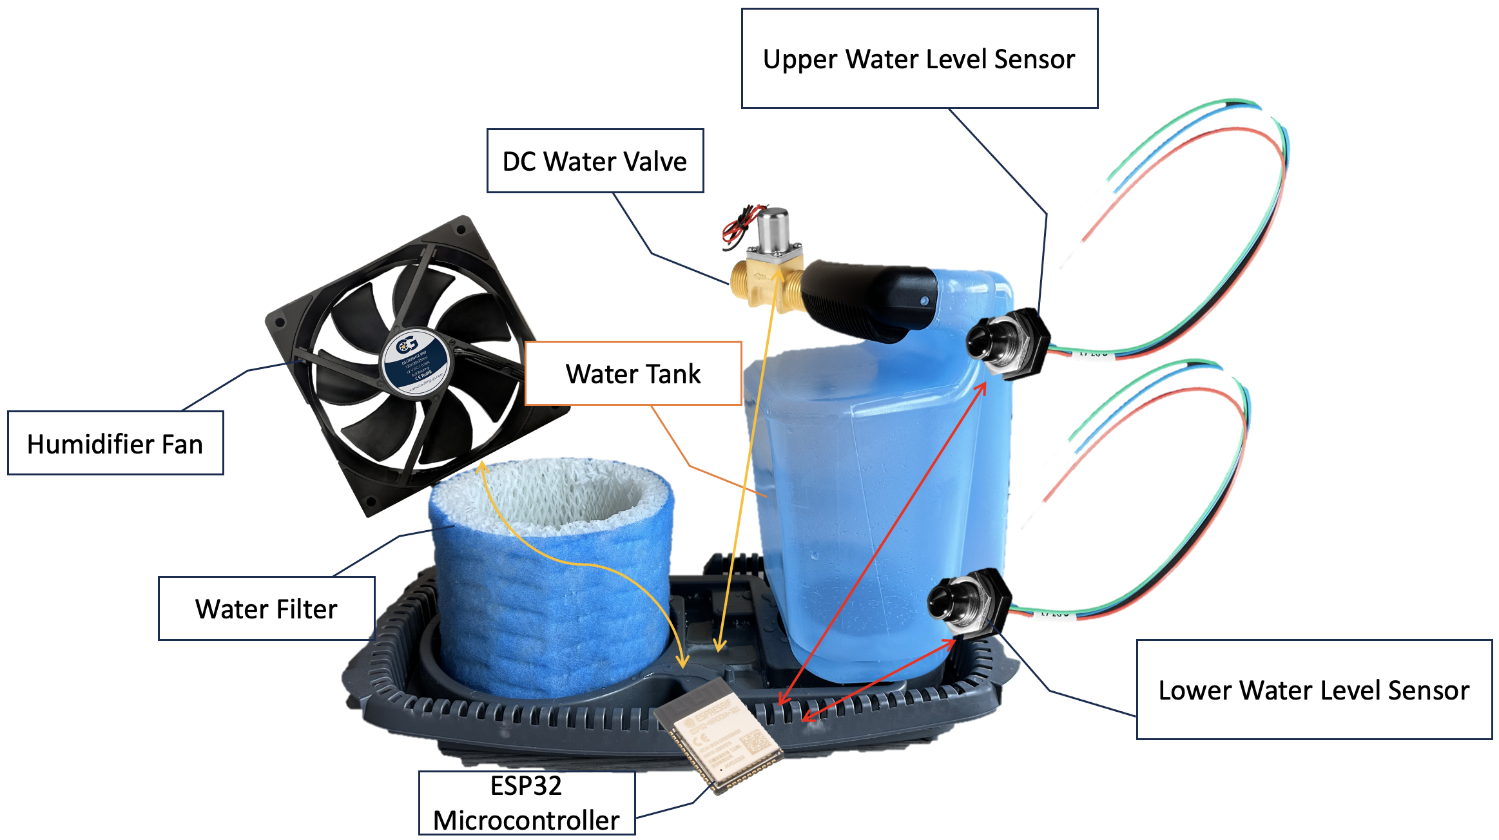
Visual Aid - Component

Slide 6

High Level 1
Humidifier's ESP32 communication with three different sensors via 2.4GHz Wi-Fi
Average humidity data from three sensors
Create temperature dependent humidity calculation algorithm
Notes:
woojin

Slide 7

High Level 2
Open/close valve to refill the water tank
Two water level sensors
Max capacity of the water tank: 4.16 liters
Filter absorbs around 150 milliliters ± 5 milliliters
Evaporation rate approximately 173 milliliters per hour
Notes:
jalen

Slide 8


High Level 3
On/off fan based on pre-configured ideal humidity range, 35% and 50% humidity, based on an algorithm averaging the readings from 3 sensors
Estimated 44ns response time to on/off the humidifier’s fan
High voltage components does not interfere with low voltage components
Notes:
jalen

Slide 9
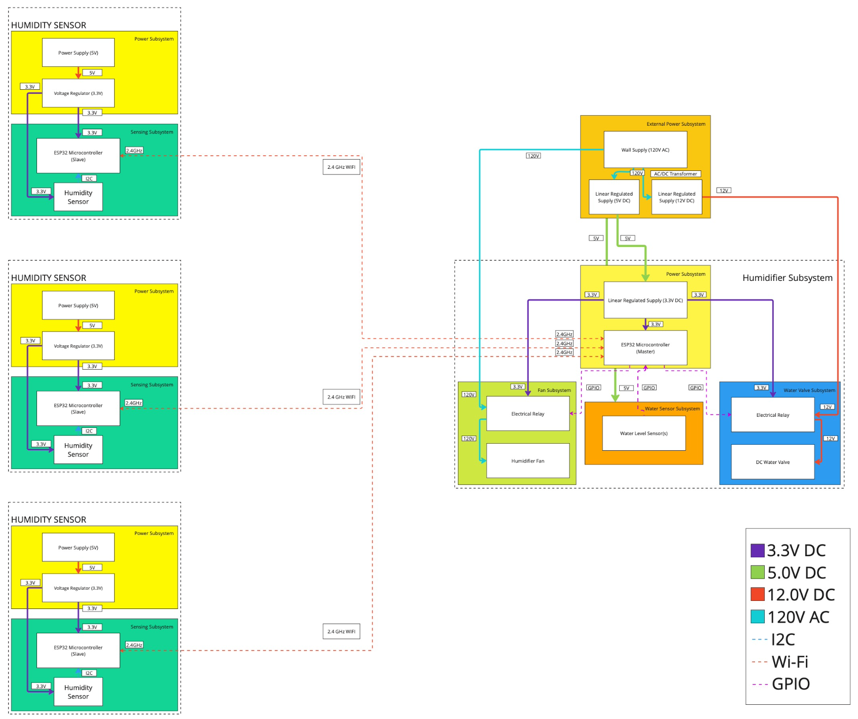
Block Diagram
Notes:
andrew

Slide 10
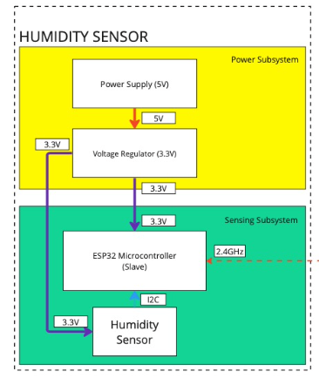
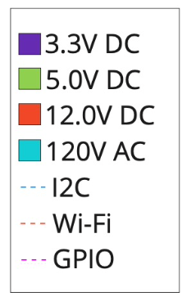
Block Diagram - Sensor
Notes:
woojin

Slide 11
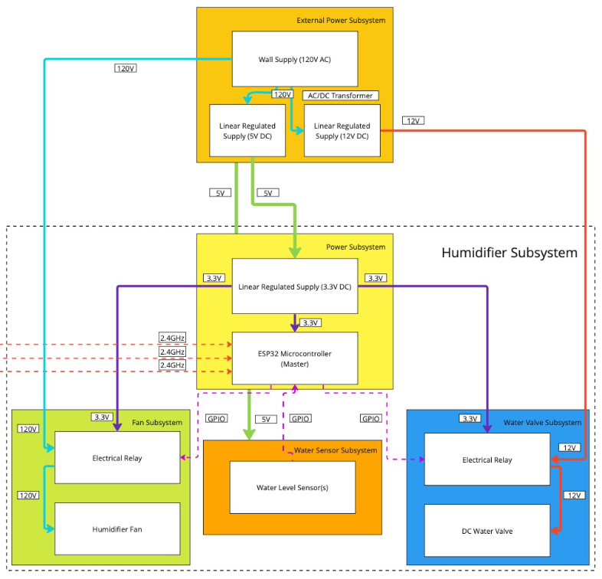
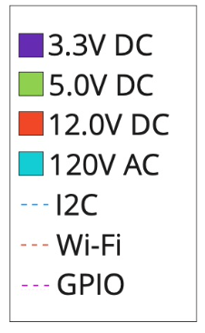
Block Diagram - Humidifier
Notes:
andrew

Slide 12
Humidifier Subsystem Requirements
5V input linearly regulated at 3.3V
ESP32 will have an access point Wi-Fi connection
ESP32 receives humidity sensor readings from other ESP32
ESP32 should turn on fan depending on set humidity range
ESP32 should read water level and operate DC water valve
Notes:
andrew

Slide 13
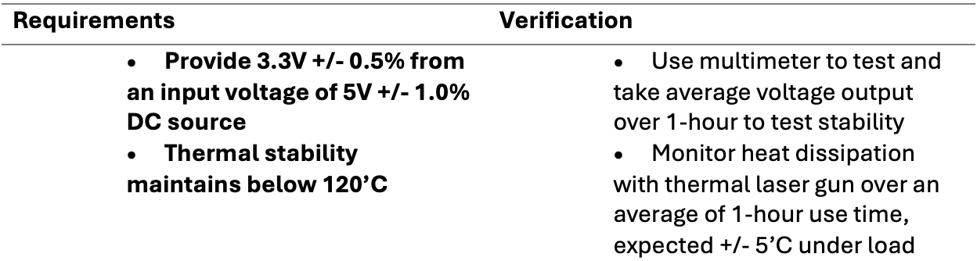
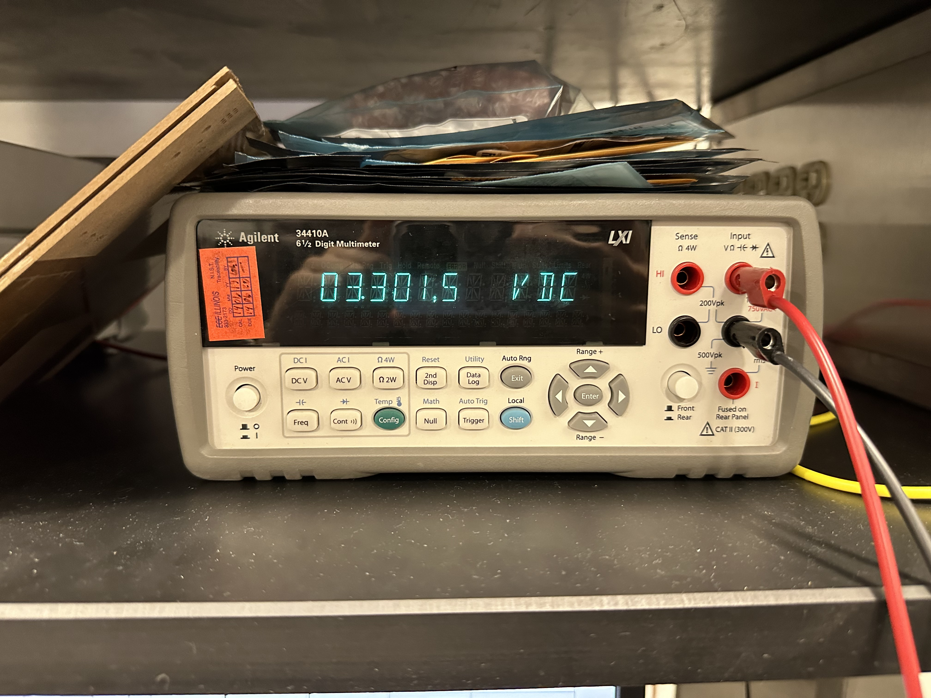
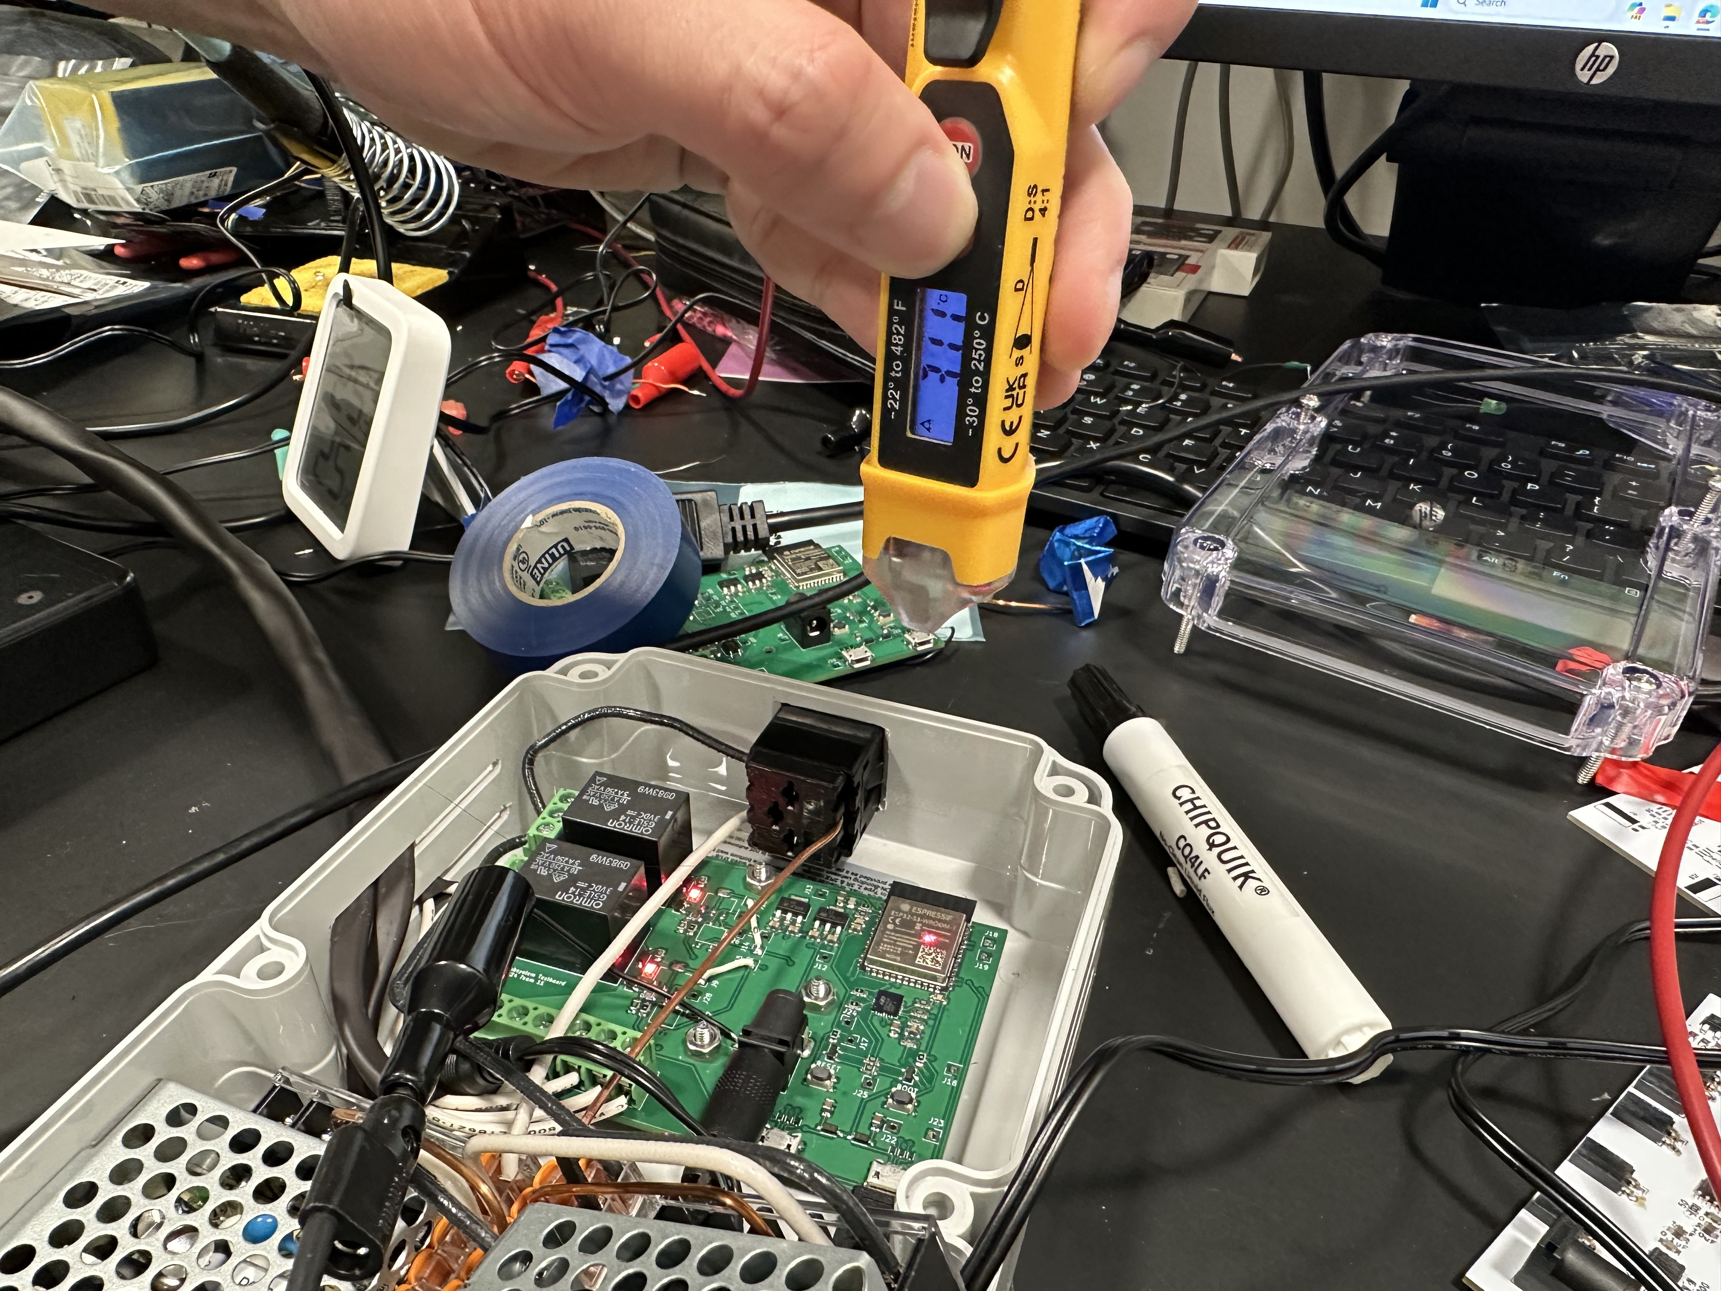
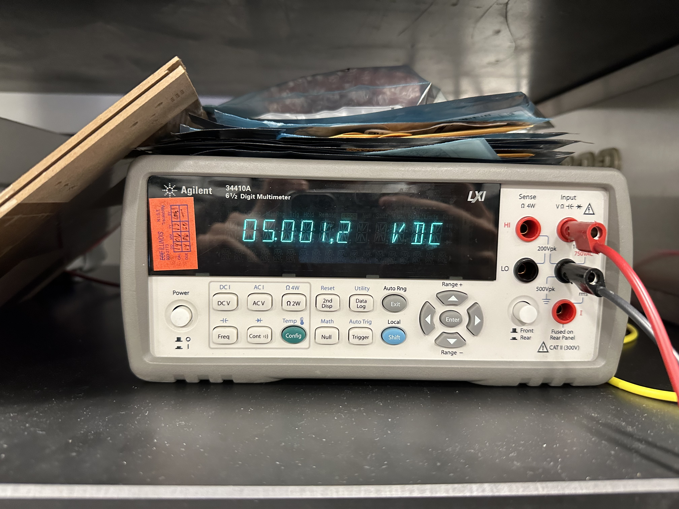
RV Table – Central Humidifier Subsystem (1)
Notes:
jalen

Slide 14
RV Table – Central Humidifier Subsystem (1)
Notes:
jalen

Slide 15
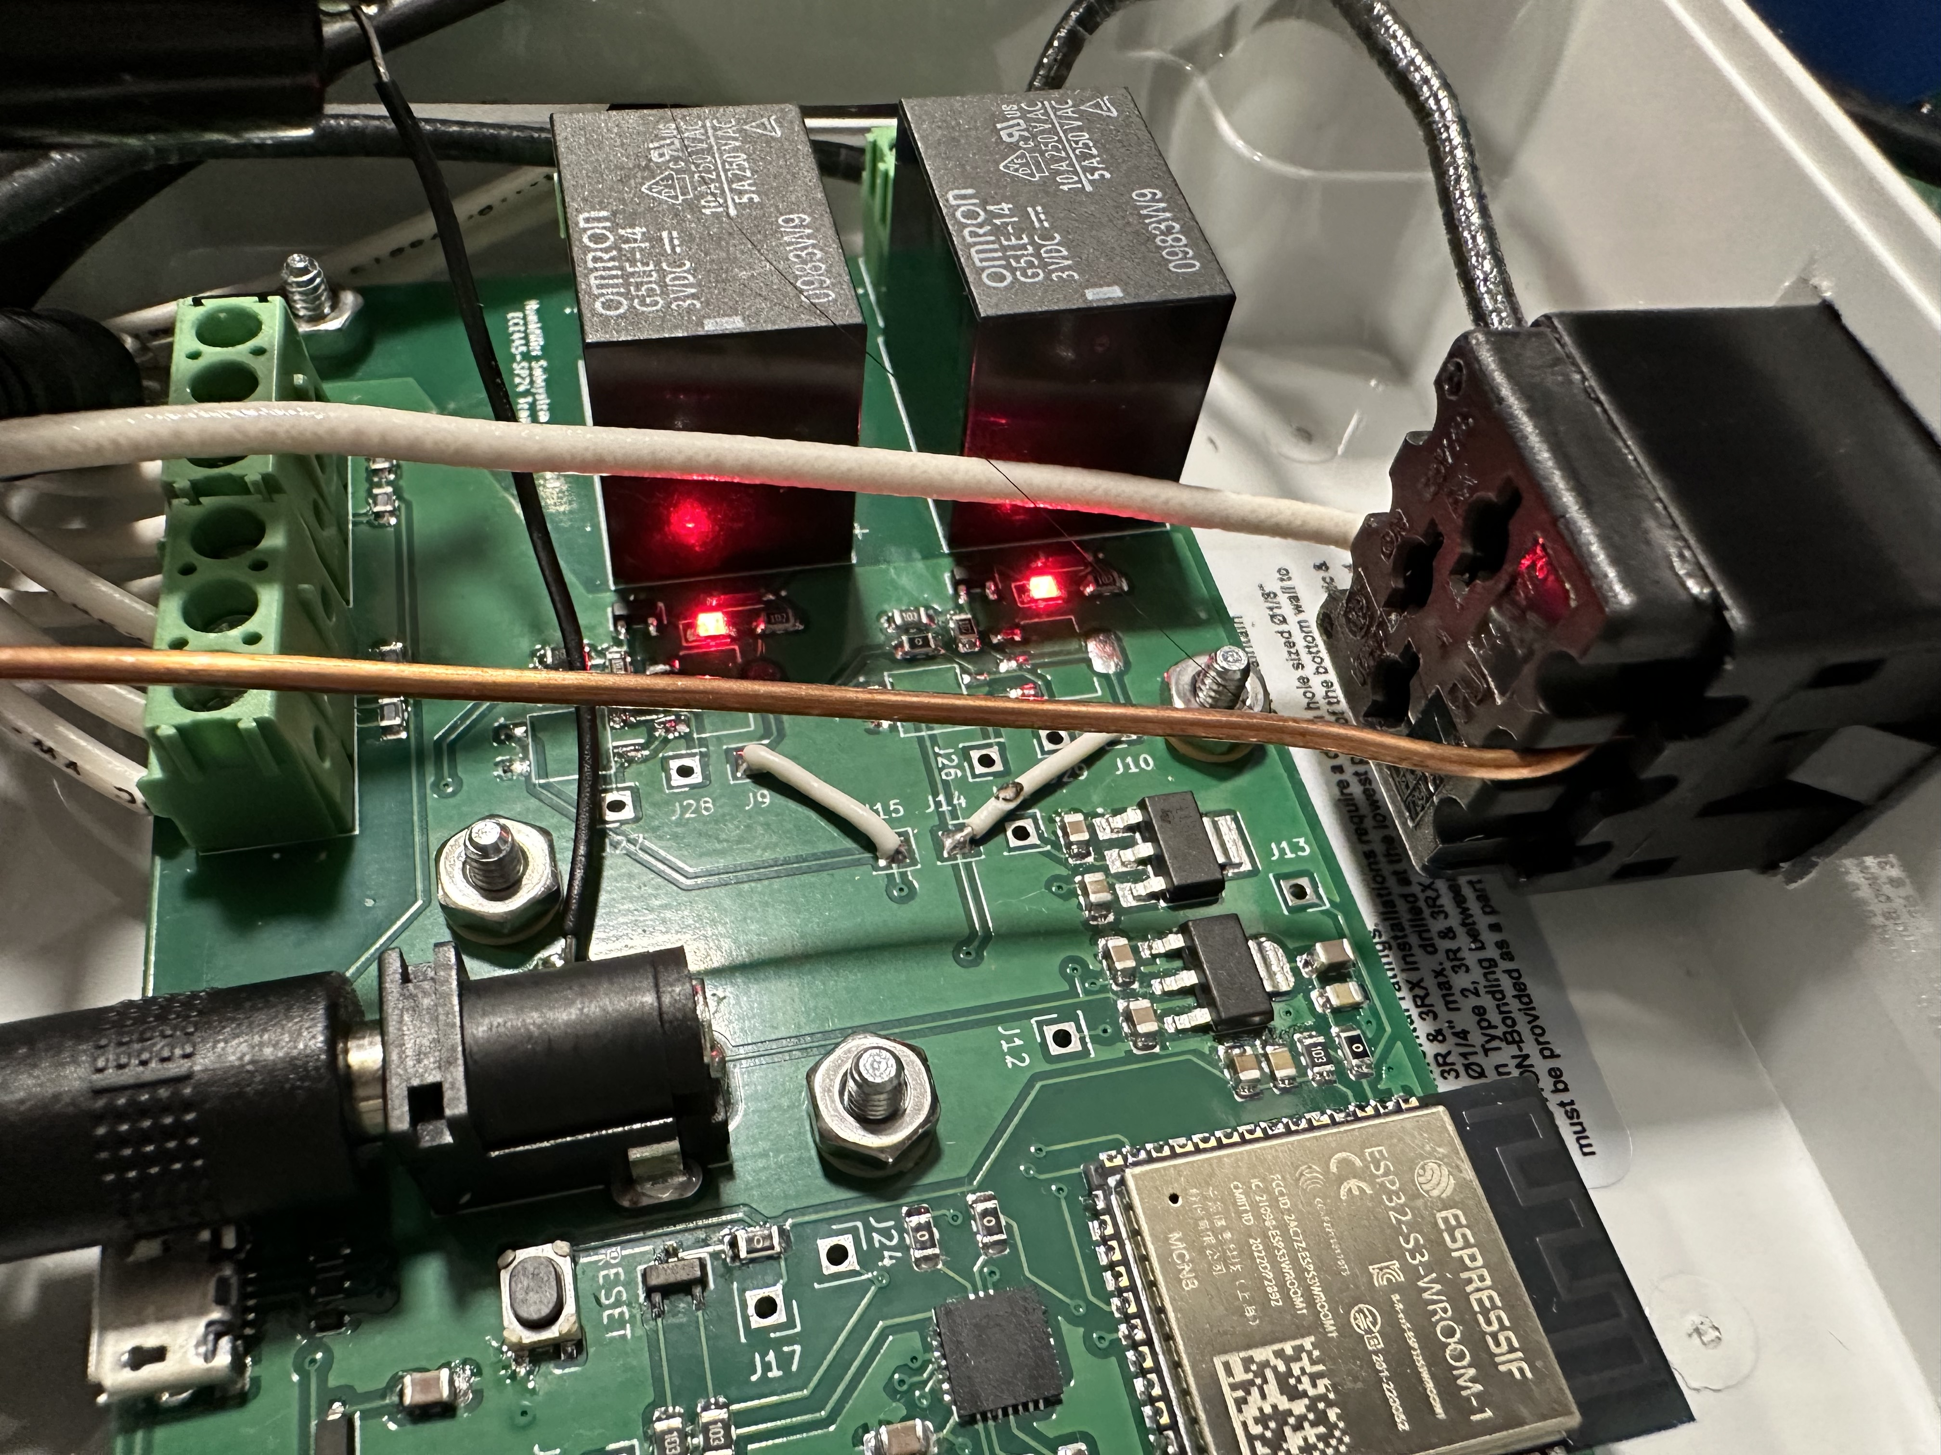
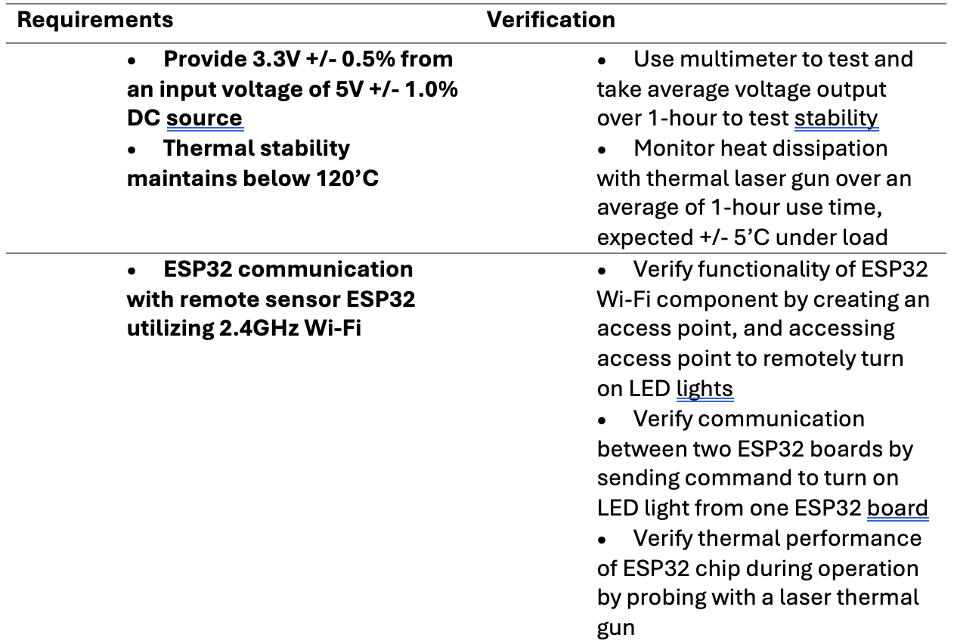
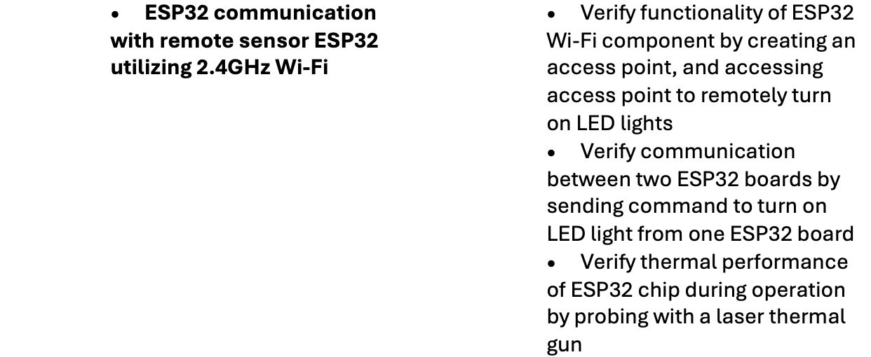
RV Table – Central Humidifier Subsystem (2)
Notes:
jalen

Slide 16
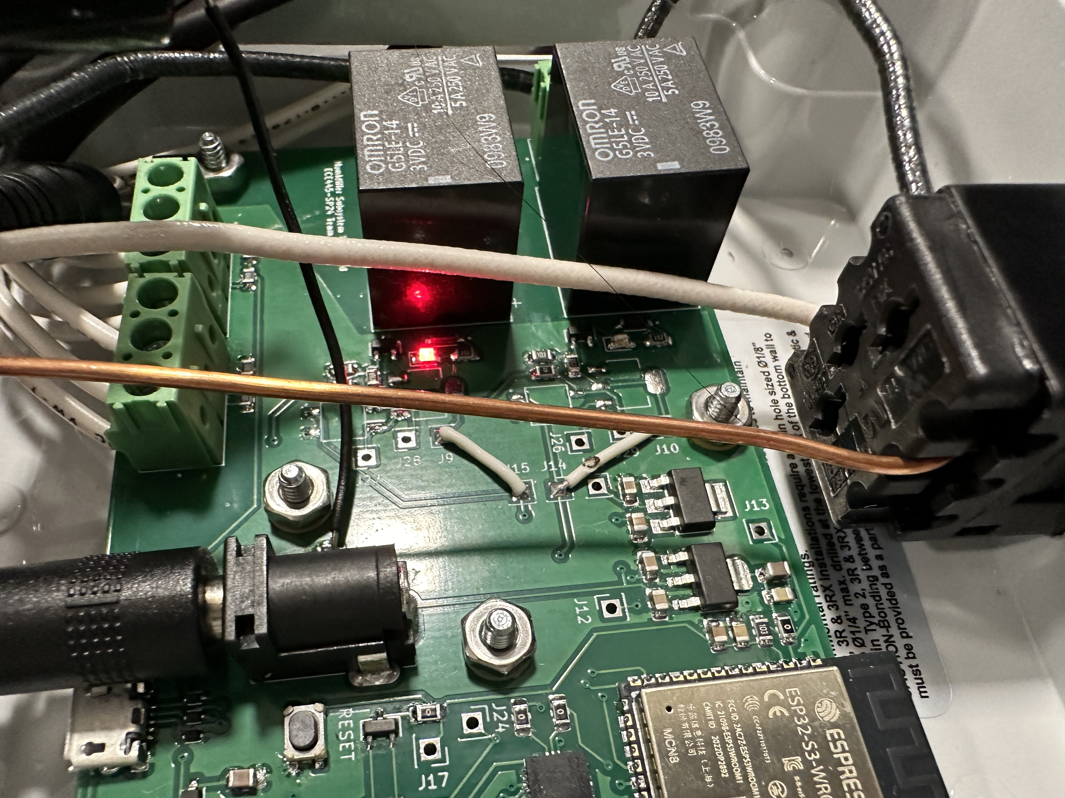
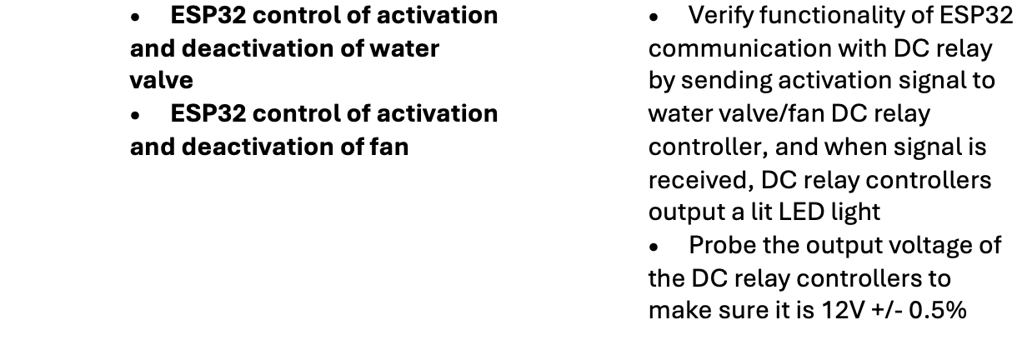
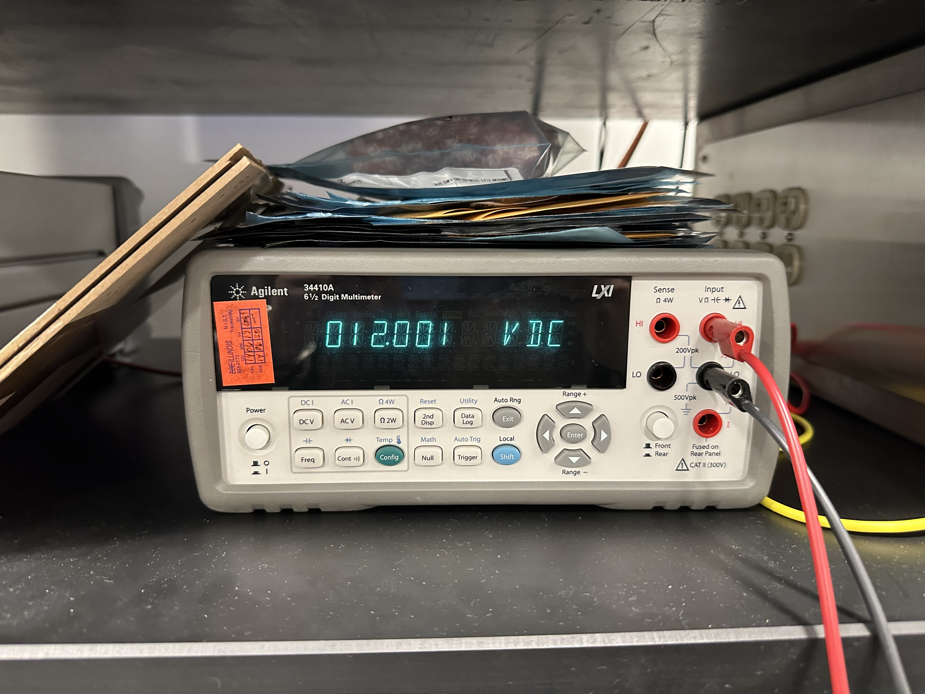
RV Table – Central Humidifier Subsystem (3)
Notes:
jalen

Slide 17
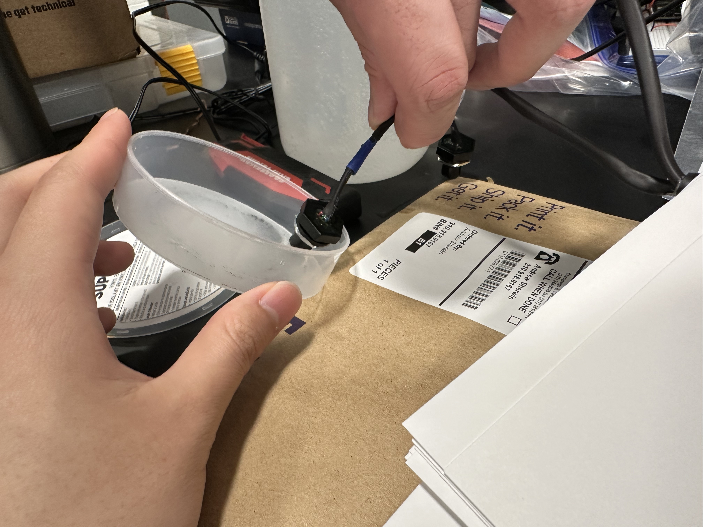
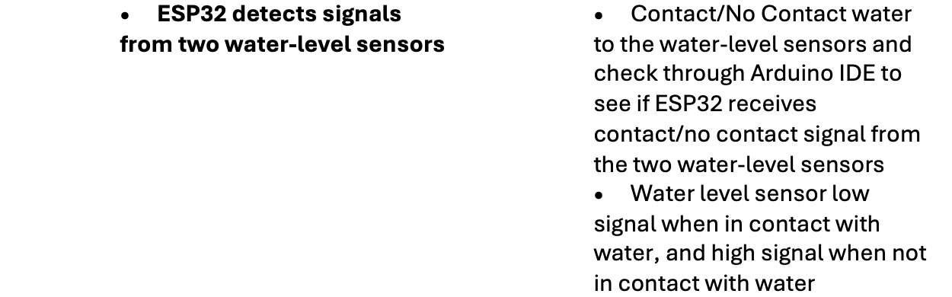
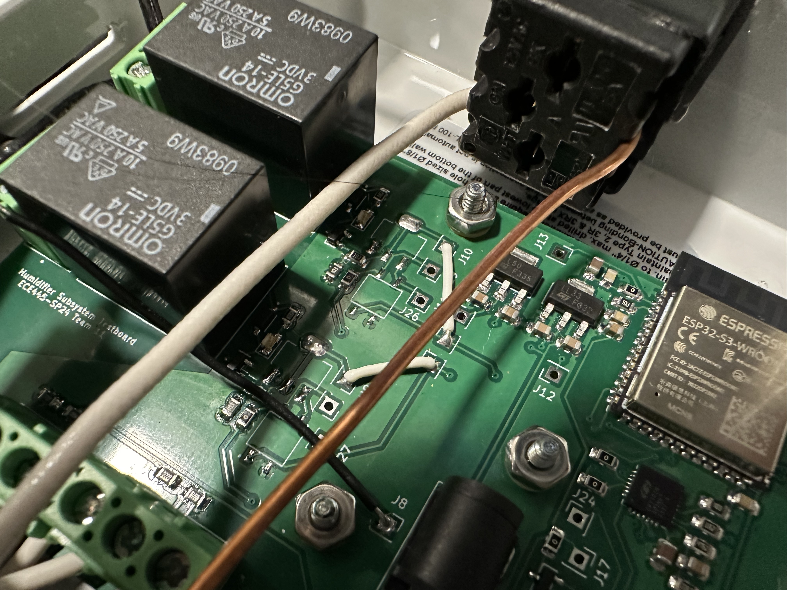
RV Table – Central Humidifier Subsystem (4)
Notes:
jalen

Slide 18
Sensor Subsystem Requirements
5V input linearly regulated at 3.3V
ESP32 sends humidity sensor readings to other ESP32
Communicate with SHT45 sensor via I2C without data loss
ESP32 will use the same frequency as SHT45
Humidity reading should be +/- 1% compared to other sensors
Notes:
woojin

Slide 19
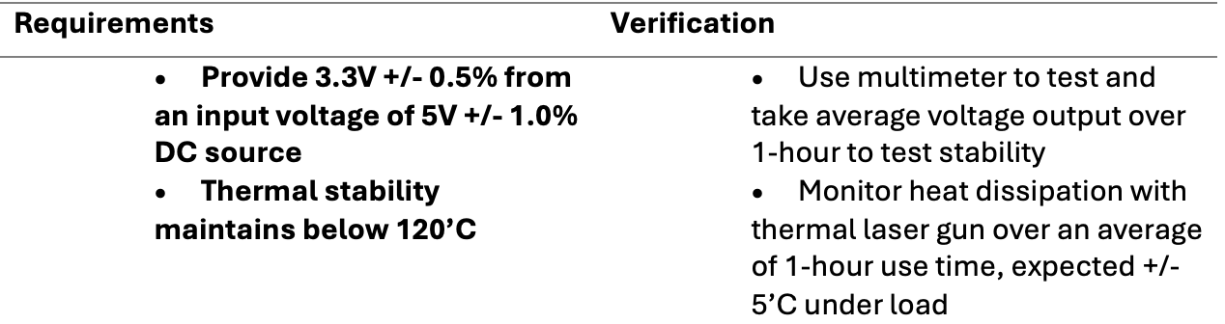
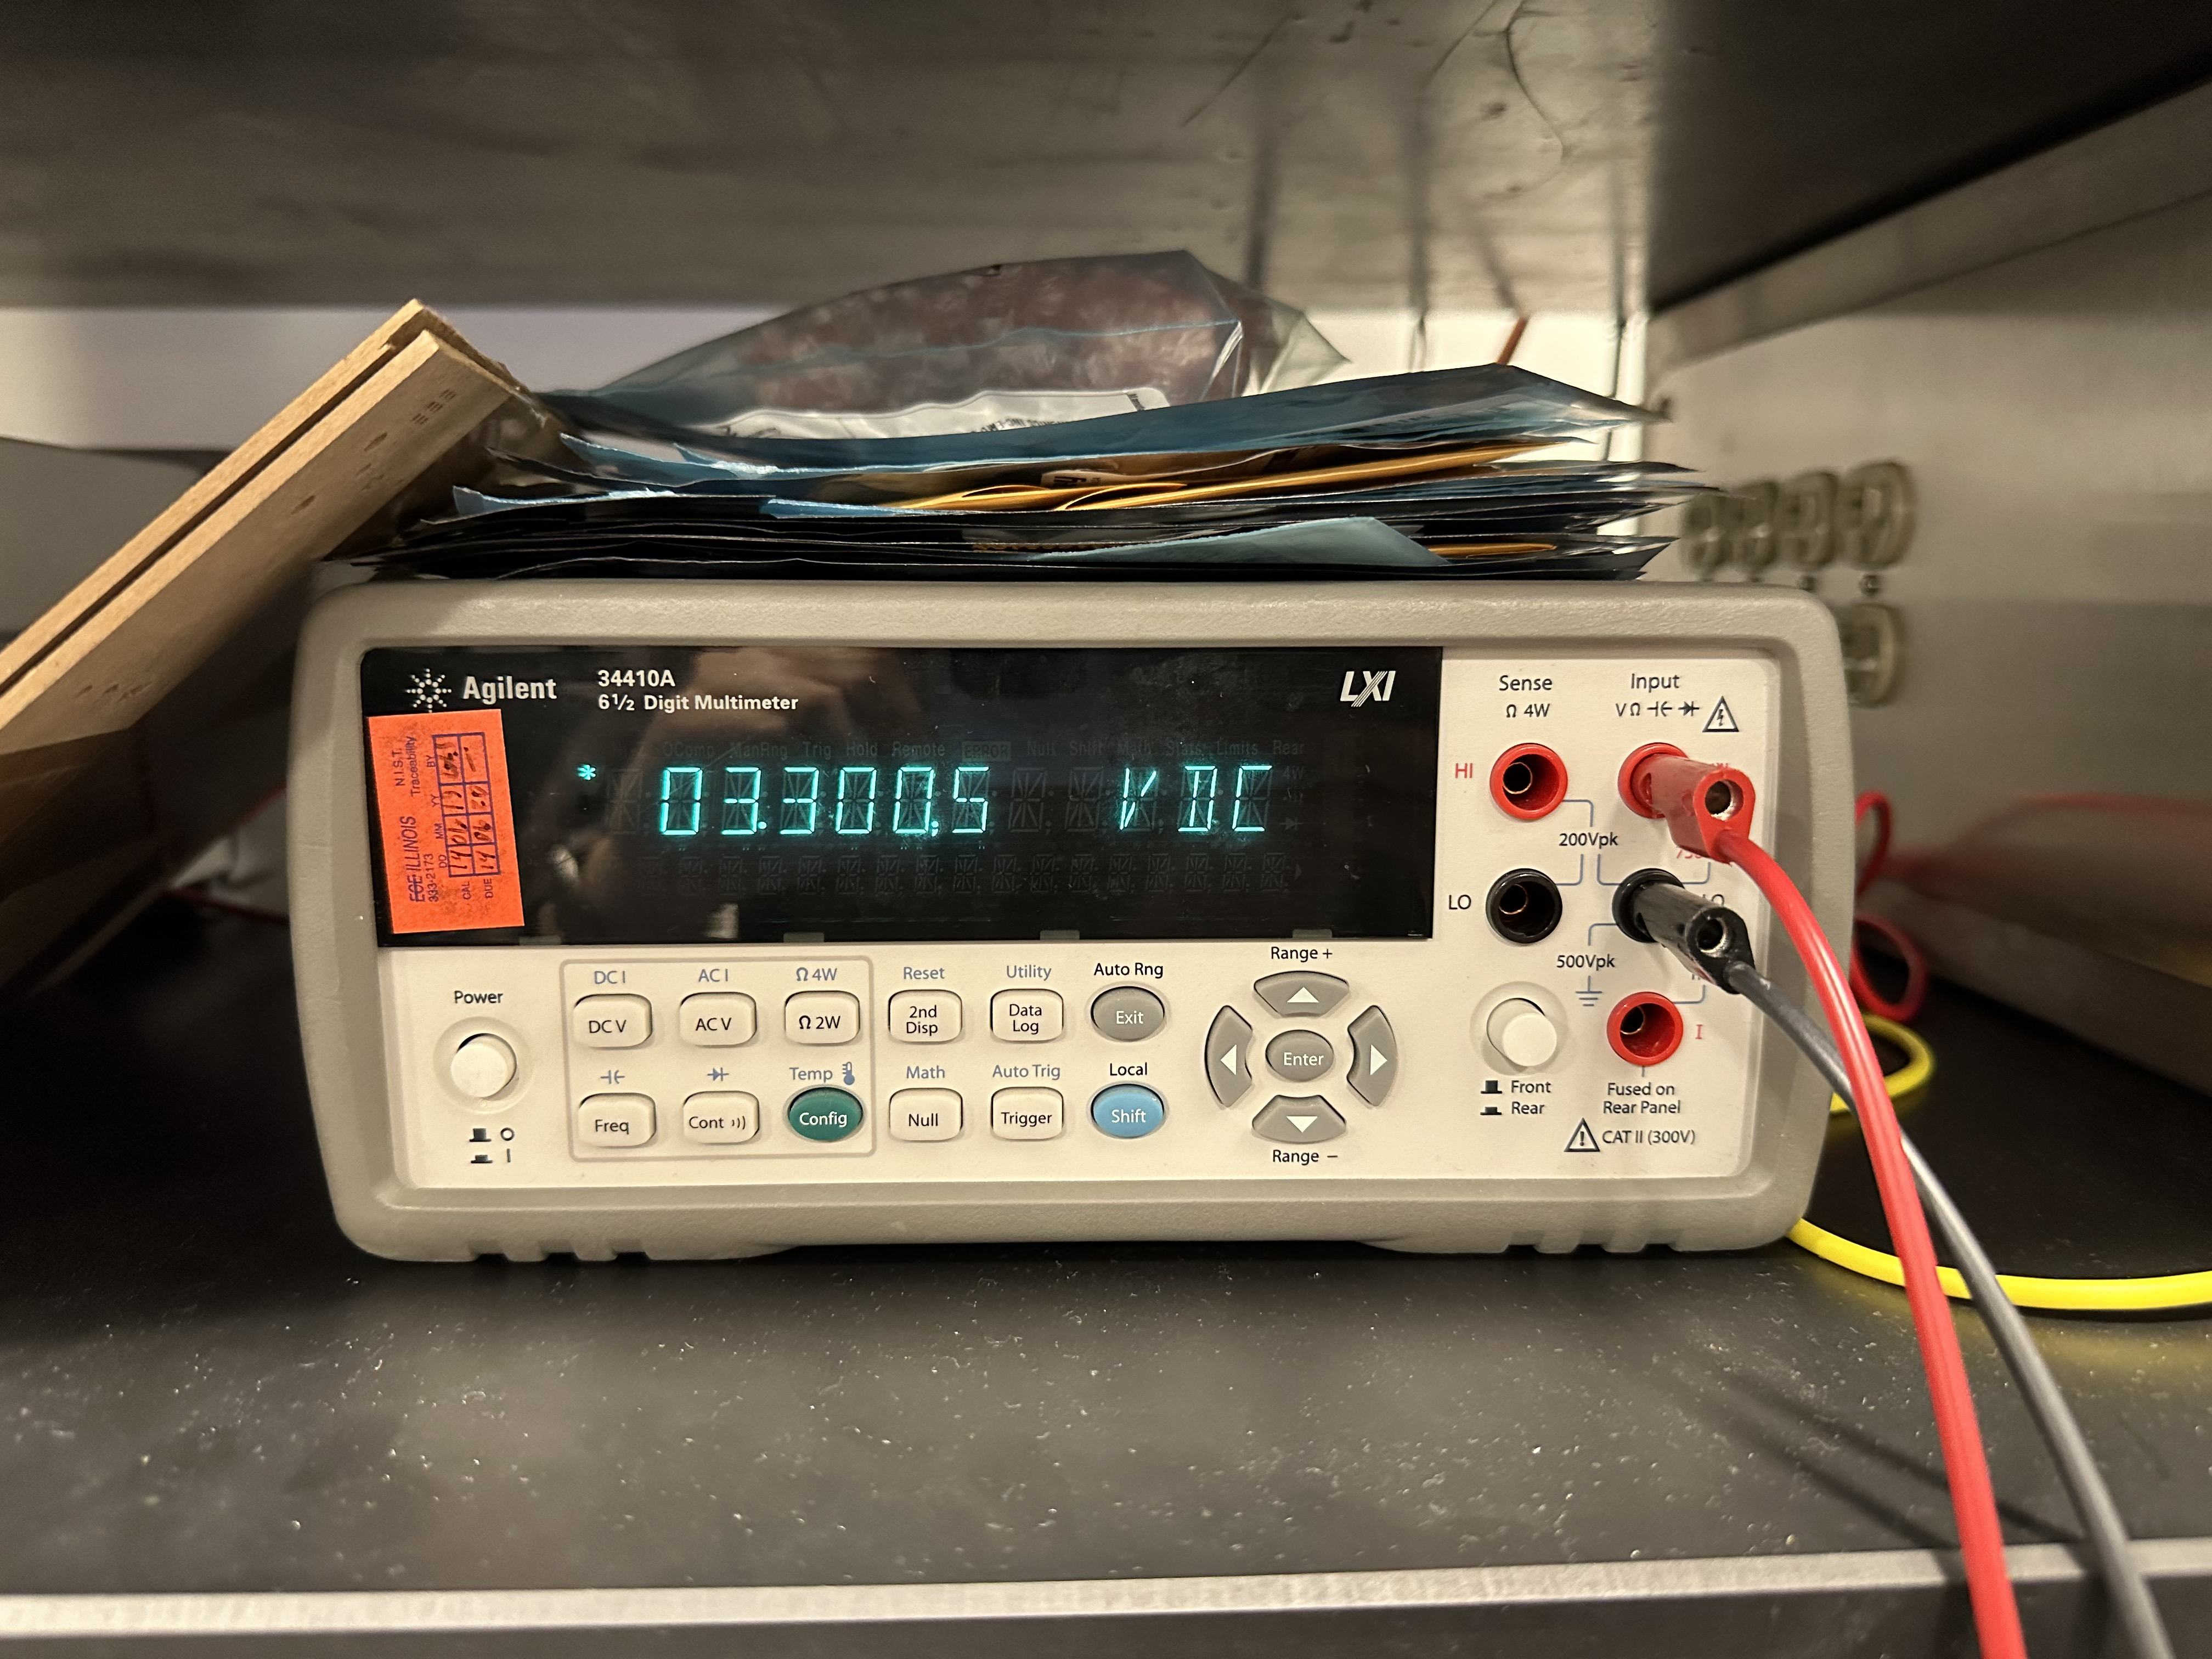
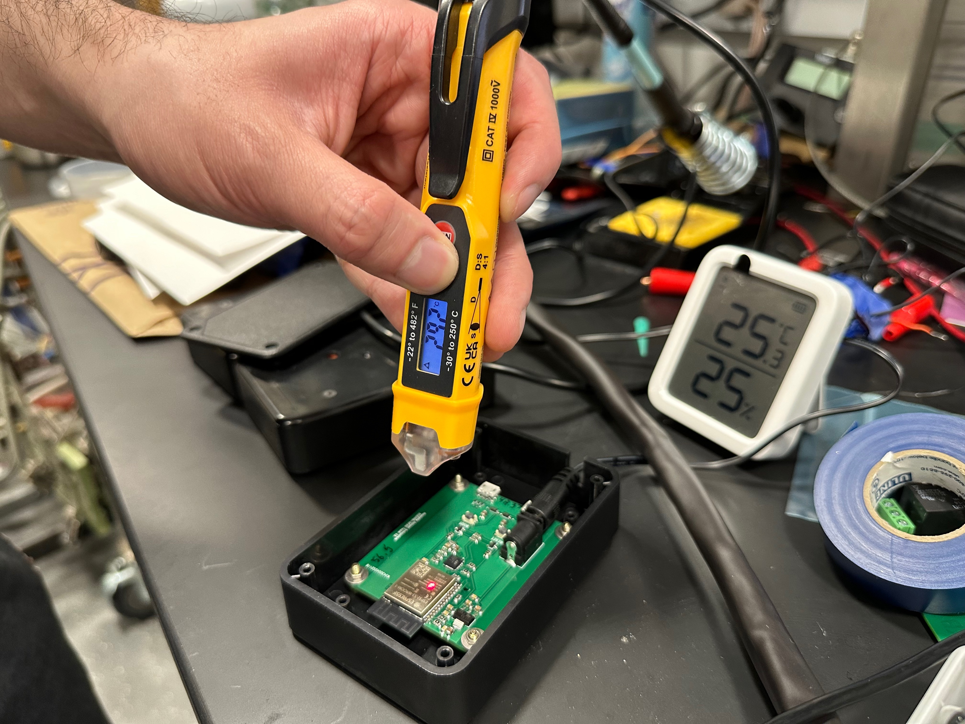
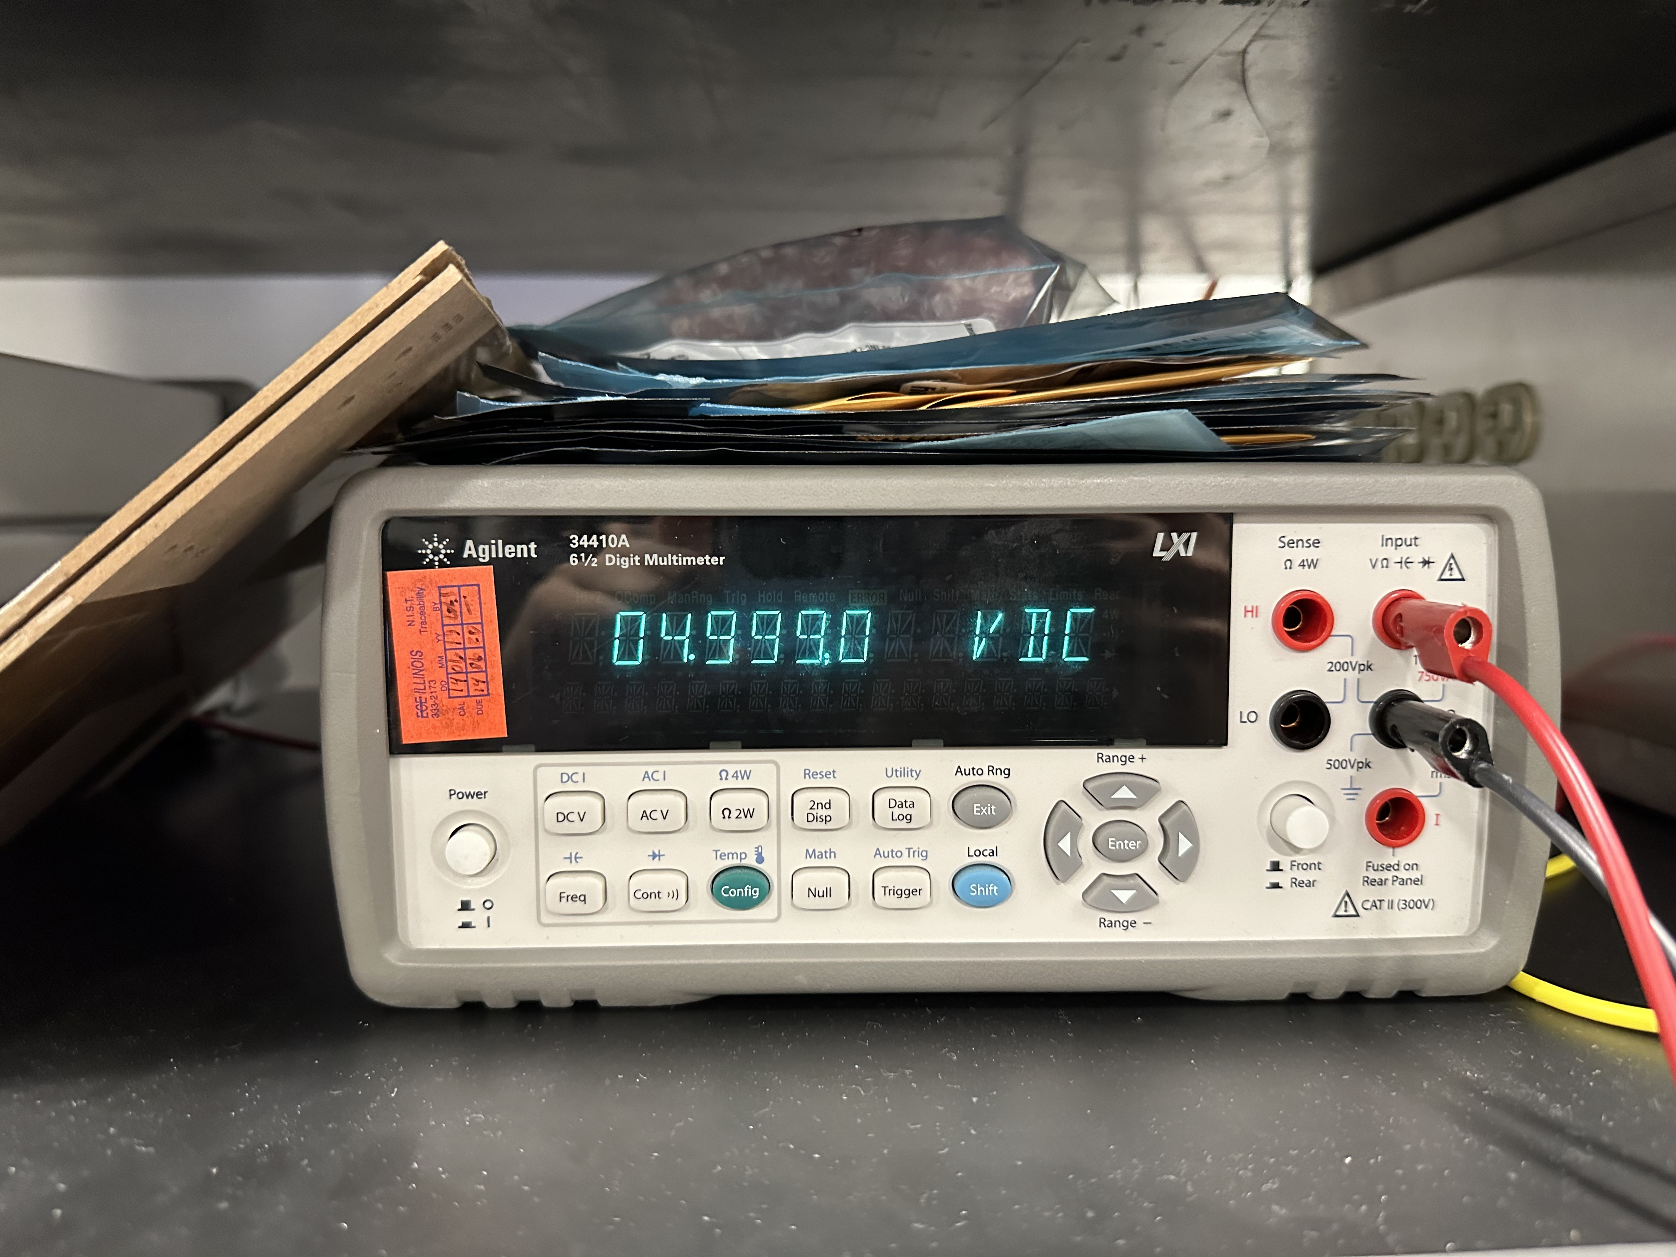
RV Table – Humidity Sensor Subsystem (1)
Notes:
woojin

Slide 20
RV Table – Humidity Sensor Subsystem (1)
Notes:
woojin

Slide 21
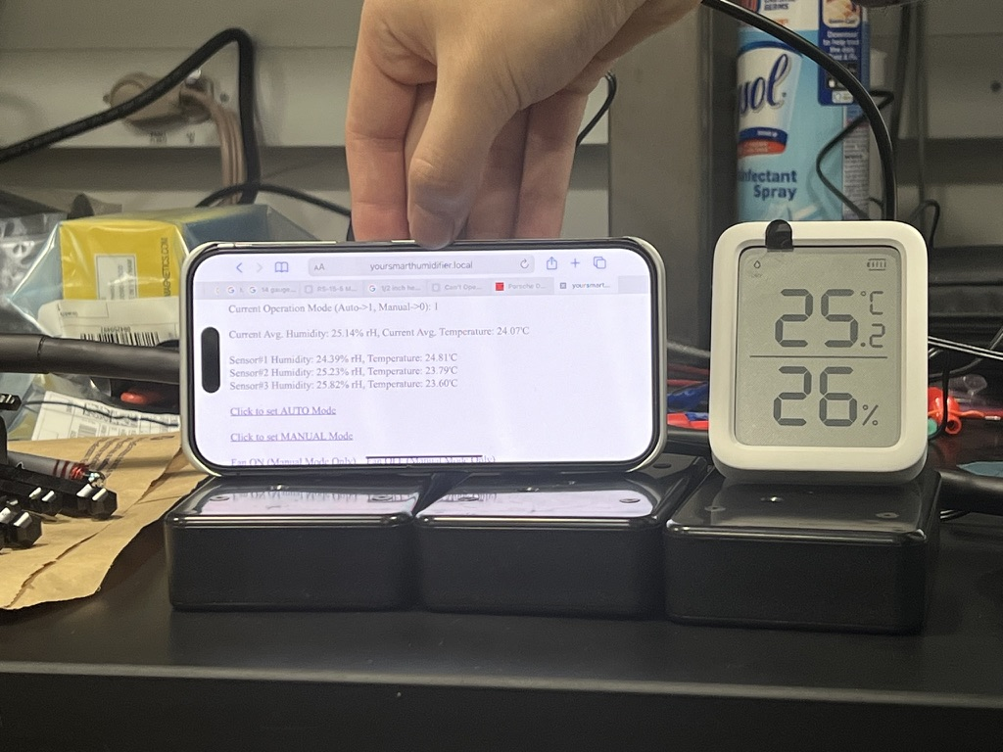
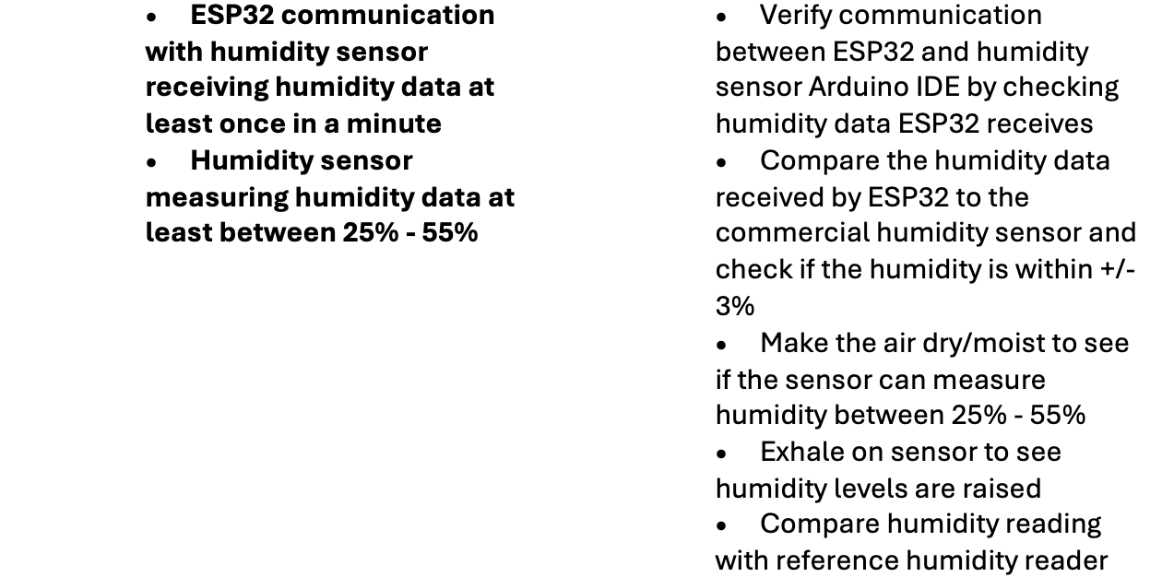
RV Table – Humidity Sensor Subsystem (2)
Notes:
woojin

Slide 22
Your Oasis Awaits: Refresh, Rejuvenate, Breathe
Notes:
Everyone//end

